Slide 1
High Level ITG Integration Use Cases

Slide 2
Example High Level Requirements
Deliver a “closed loop” view by pushing policy information to the IT execution layer, continuously monitoring compliance using inputs from sources of risk (i.e. security systems), comparing them with regulatory and internal requirements, and identifying gaps
Combine top down policy and business controls with bottom up operational IT data to deliver real time visibility into risk and compliance posture
Map different types of IT operational data to a single control framework
Understand bus and risk impact of IT incidents and events
Centralized risk and compliance data collection and reporting
Take sources of risk, compare them with requirements, identify gaps, correlate them and produce a prioritized output view
Help find things before they happen
  Being alerted that there is elevated risk somewhere and deal with it rather than knowing about it after the risk happened, or auditors or customers find and are aware of it.
  Surface the analytics and “head light” view of risks and issues before they become an “incident

Slide 3
Potential Points of Integration
Data brought into OP from IT/monitoring systems
Test Results
Key Indicators (KRI/KPI/KCI)
Incidents
Assets/Resources
Vulnerability Reports
Data pushed to OP from IT/monitoring systems
“Policies” - may actually be Requirements, Controls, etc
Test Plan data
Key Indicator Definitions
Business Hierarchy data

Slide 4
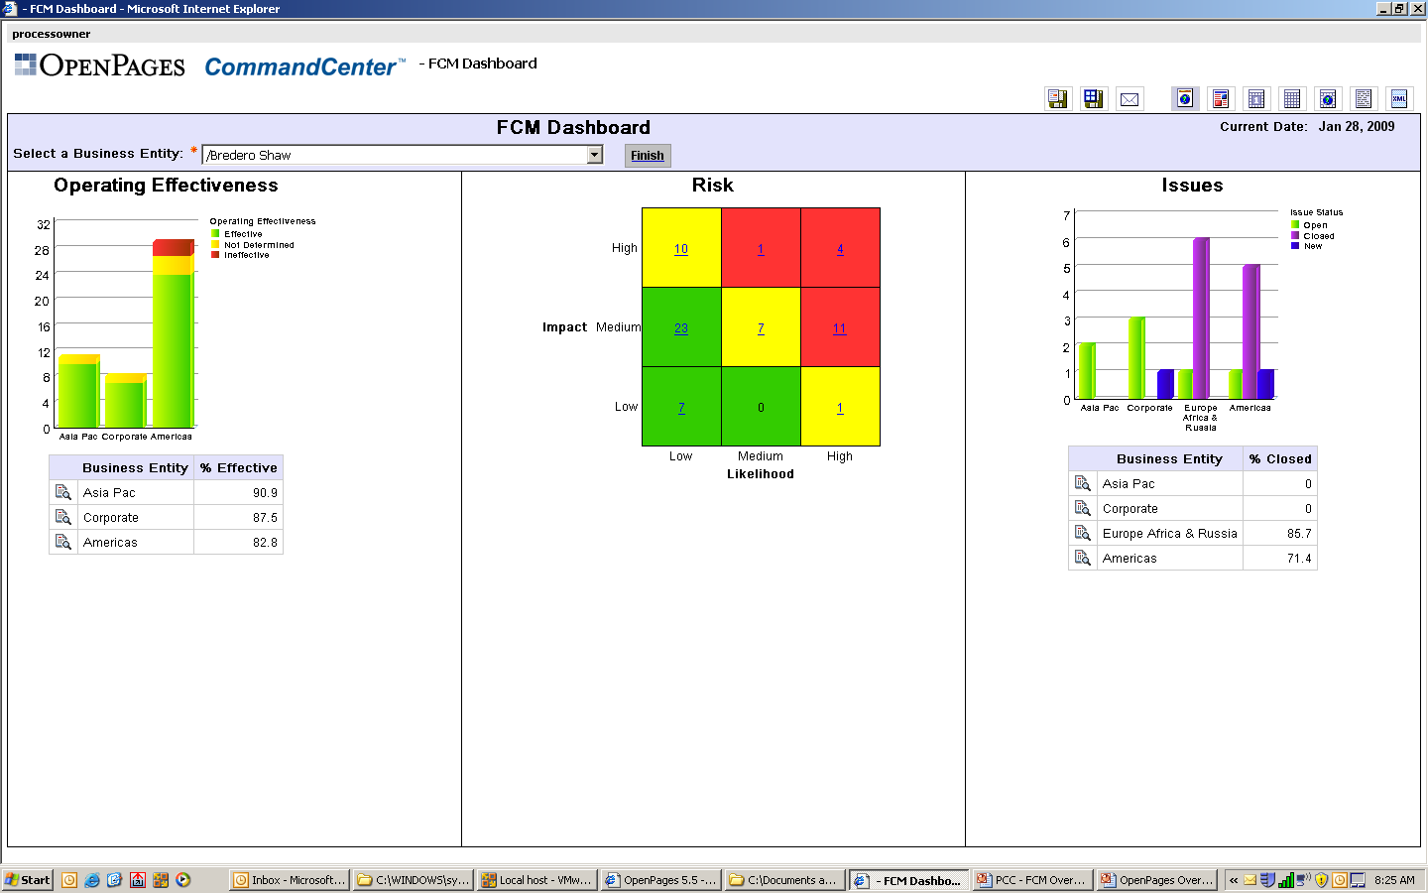

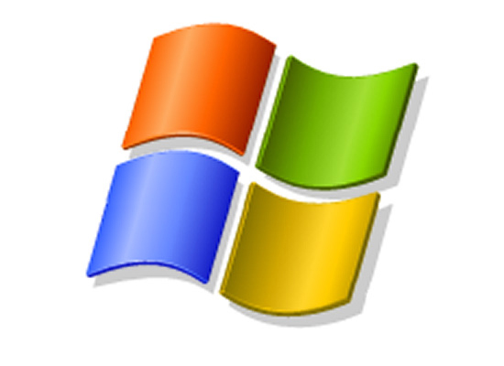
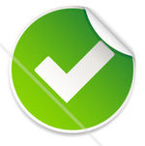
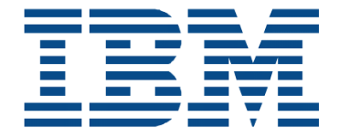
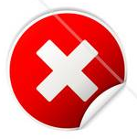
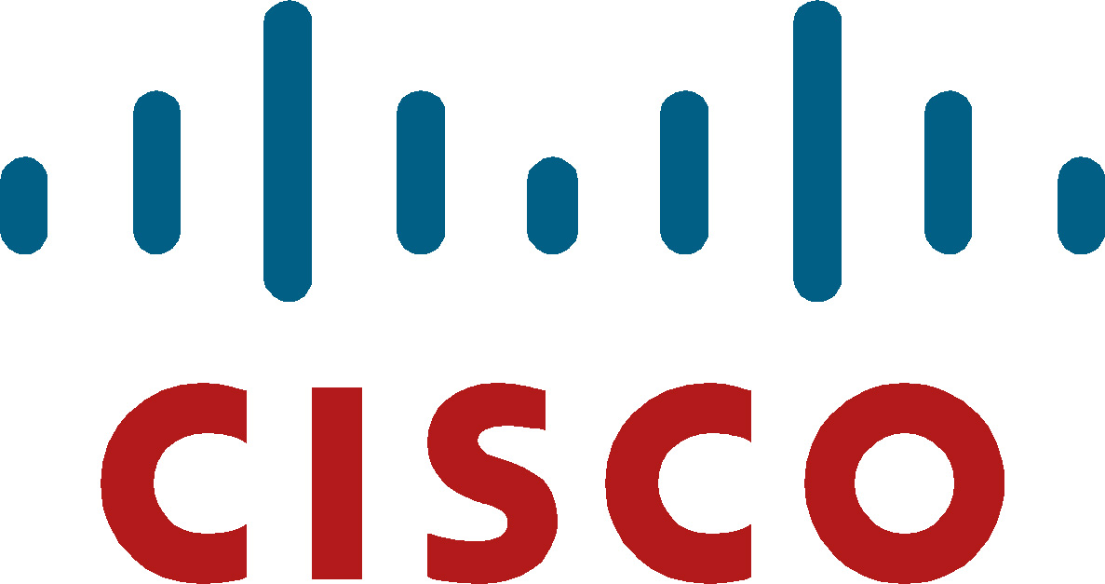
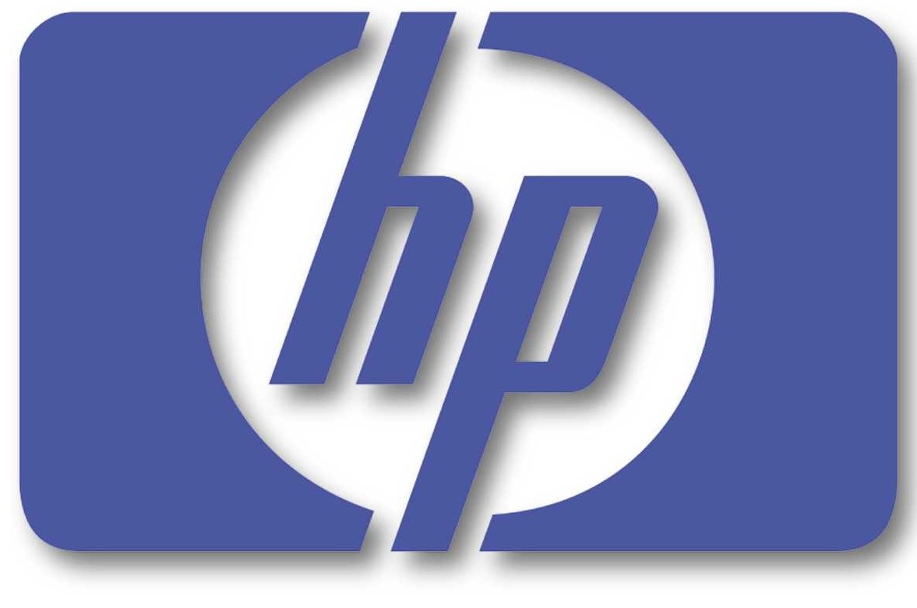

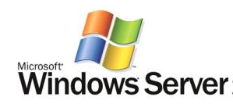
Managing IT Policies and Controls, Risk Monitoring, Incidents
Regulation/Policy
Risk
UCF Requirement
‘No default passwords’
Key Indicators
Incidents
Control
‘All default passwords have been changed’
‘Weekly Virus Threats’
Threshold = 75
‘SAN Switch Failure’
‘Customer DB Hacked’
‘Intranet Down’
Password
Status
IT Assets
Values
1/1-1/7 = 40
1/8-1/15 = 60
1/16-1/23 = 90
…
Vulnerability
Control
Infrastructure
Configuration
Database
VA system
Password & Config. Files
Resources
Notes:
Describe module deployment (all 4) and shared services on common repository

Slide 5
OP/Q1 Prototype -- a few integration scenarios
Client has OpenPages and Q1 (SIEM) and is looking for IT GRC solution to utilize SIEM and other IT data to inform GRC processes and/or reporting
  Operations Manager wants to look at Q1 to see number/trends of network intrusions
  CxO uses OpenPages to manage and report on risk and compliance initiatives
  → IT Risk is considered in the context of the business
Client has OpenPages and IT Execution/Monitoring System (i.e. TEM, Guardium) and is looking for IT GRC solution to utilize IT source data to inform GRC processes and/or reporting (no SIEM in use)
  Operations Manager wants to look at TEM/Guardium to see number/trends of network intrusions
  CxO uses OpenPages to manage and report on risk and compliance initiatives
  → IT Risk is considered in the context of the business

Slide 6
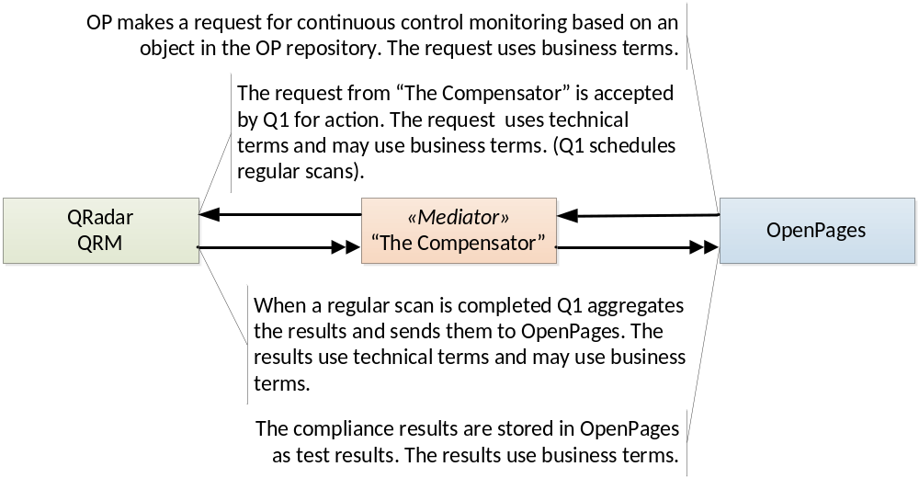
OP/Q1 Prototype
Request flow – continuous compliance monitoring

Slide 7
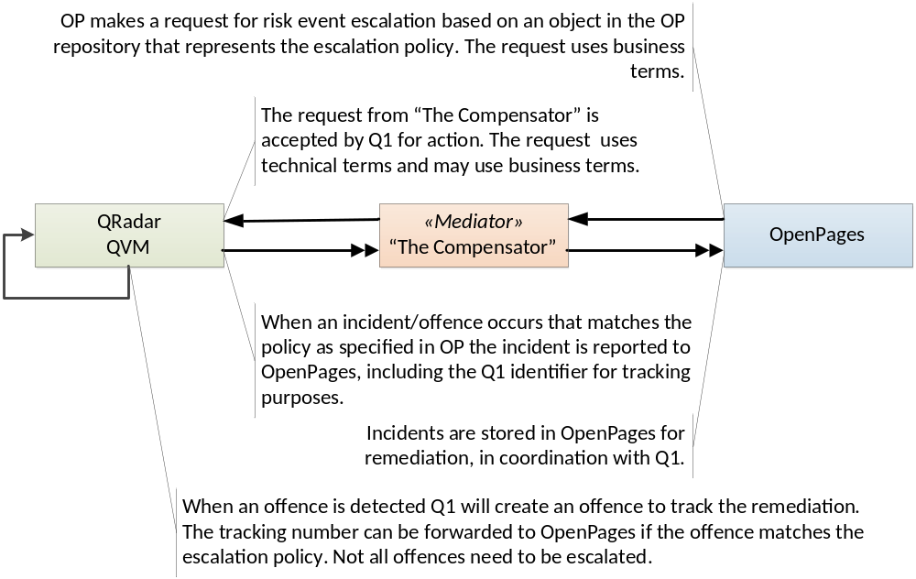
OP/Q1 Prototype
Request flow – risk event escalation

Slide 8
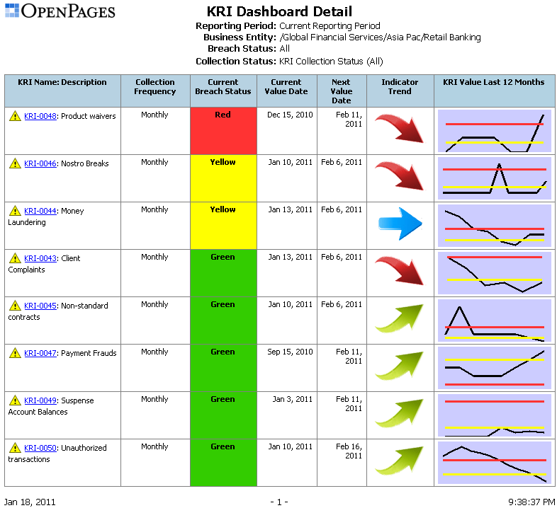
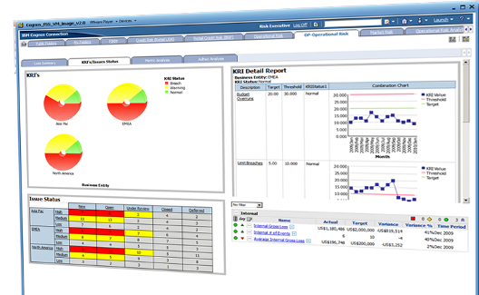
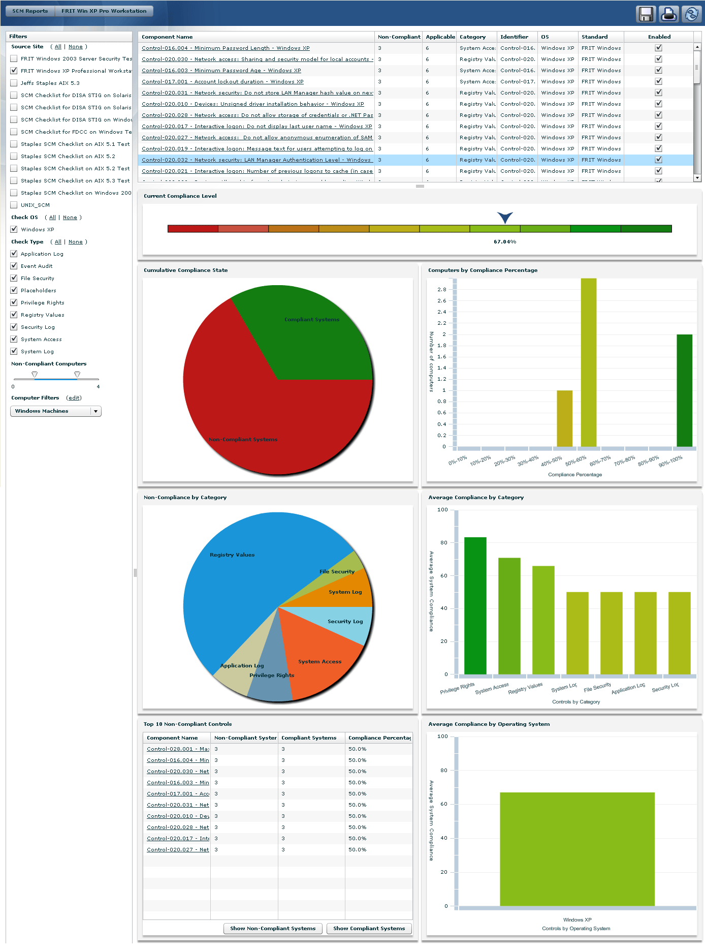
Drive effective monitoring using rich asset, security compliance and configuration management data
Example: Integration with Tivoli Endpoint manager
Business Intelligence
Tivoli Endpoint Manager
Patch Management
Risk and Compliance Management
Control Testing
Key Indicators
Incident Mgmt
Issue
Remediation
Security Configuration Management
Regulation, Policy and Control Libraries
Vulnerability Management
SOX Compliance
PCI/Privacy Compliance
IT Policy Compliance
Others As Required
Industry Standards
COBIT, ISO, NIST, DISA
Technical Policy Management | Continuous Monitoring | Prevention, Detection and Remediation
Notes:
Regulation, Policy and Control libraries help to introduce standardization across the IT infrastructure.
Then automating the monitoring activities drive down costs, increase efficiencies and quality of data
Continuous and proactive
Tivoli Endpoint Manager for Security and Compliance contains libraries of technical controls and compliance reporting tools based on industry best practices and standards for endpoint and server security configuration.
Through Open Pages’ Cognos reporting, users can see status of IT policies & controls and the impact of the effectiveness in dashboards on a close to real-time basis.

Slide 9
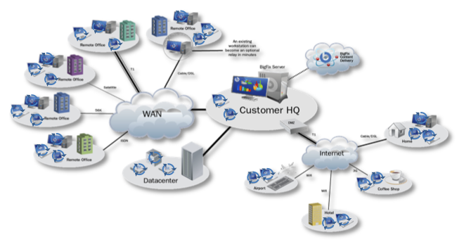
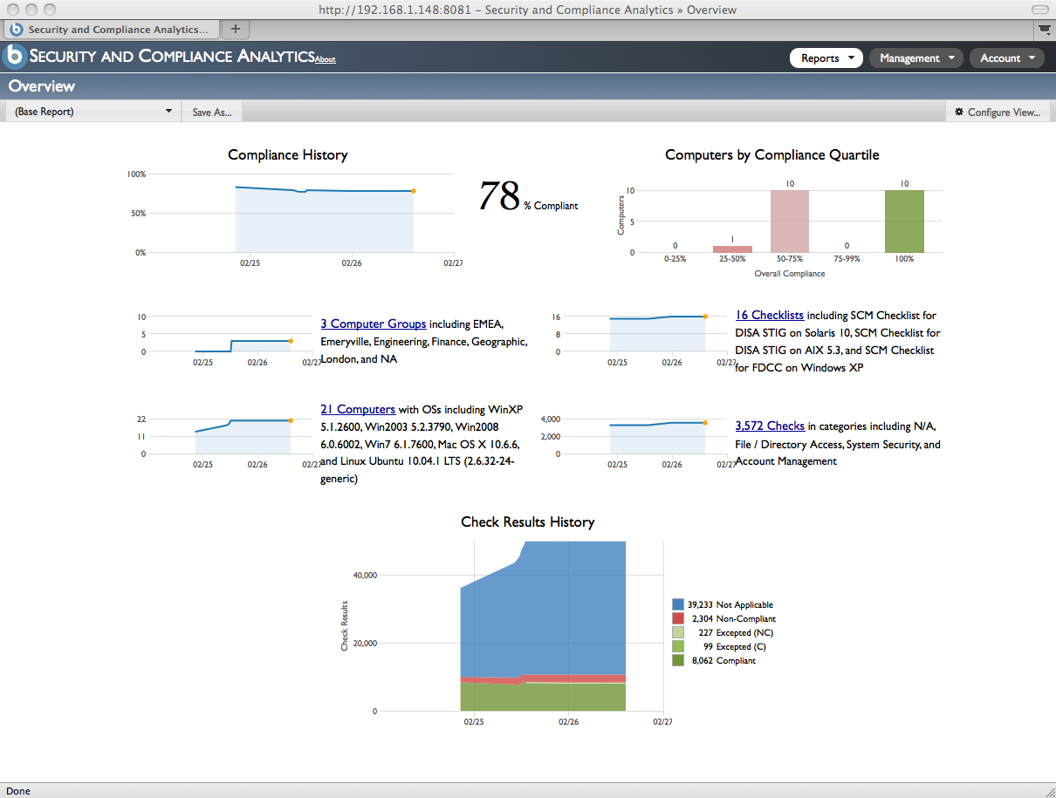
TEM for Security and Compliance
OpenPages GRC
Continuously monitor and enforce
Provide real-time visibility
Identify and remediate critical gaps
Aggregate and drill-down reporting
Integrated analysis and reporting
Manage control environment, obligations, corporate policies and processes
Dashboards for corporate risk and compliance
Continuous Compliance

Slide 10
OP/TEM Demo Use Case
Supports Quarterly PCI Reporting
On a periodic basis (i.e. Quarterly), Info Sec team reports on PCI Control effectiveness
Manually run a Global Notification Report that kicks off the process of identifying which Test Plans (CCE’s) need to be run and calling the appropriate TEM data (Note: This process would be scheduled and automated in real life)
Notification looks for any Test Plans flagged as ‘Automated’ with TEM as the source system and calls Policy Check data by CCEs and computer properties
TEM data is brought into OpenPages and used to create a Test Result record for each Test Plan (CCE)
PCI Dashboard presents aggregated control and test data by Business Entity and Business Service

